Slide 1

Guide to completing the PSEA Ad Hoc Withdrawal FormSG

Slide 2
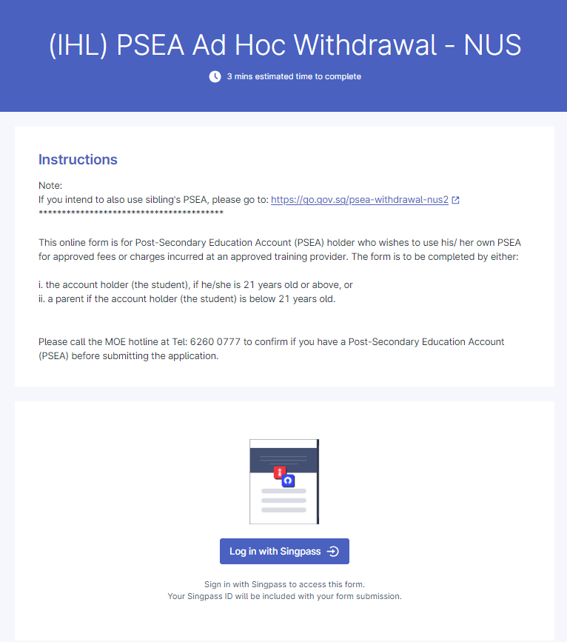
2) Click button to begin.

Slide 3
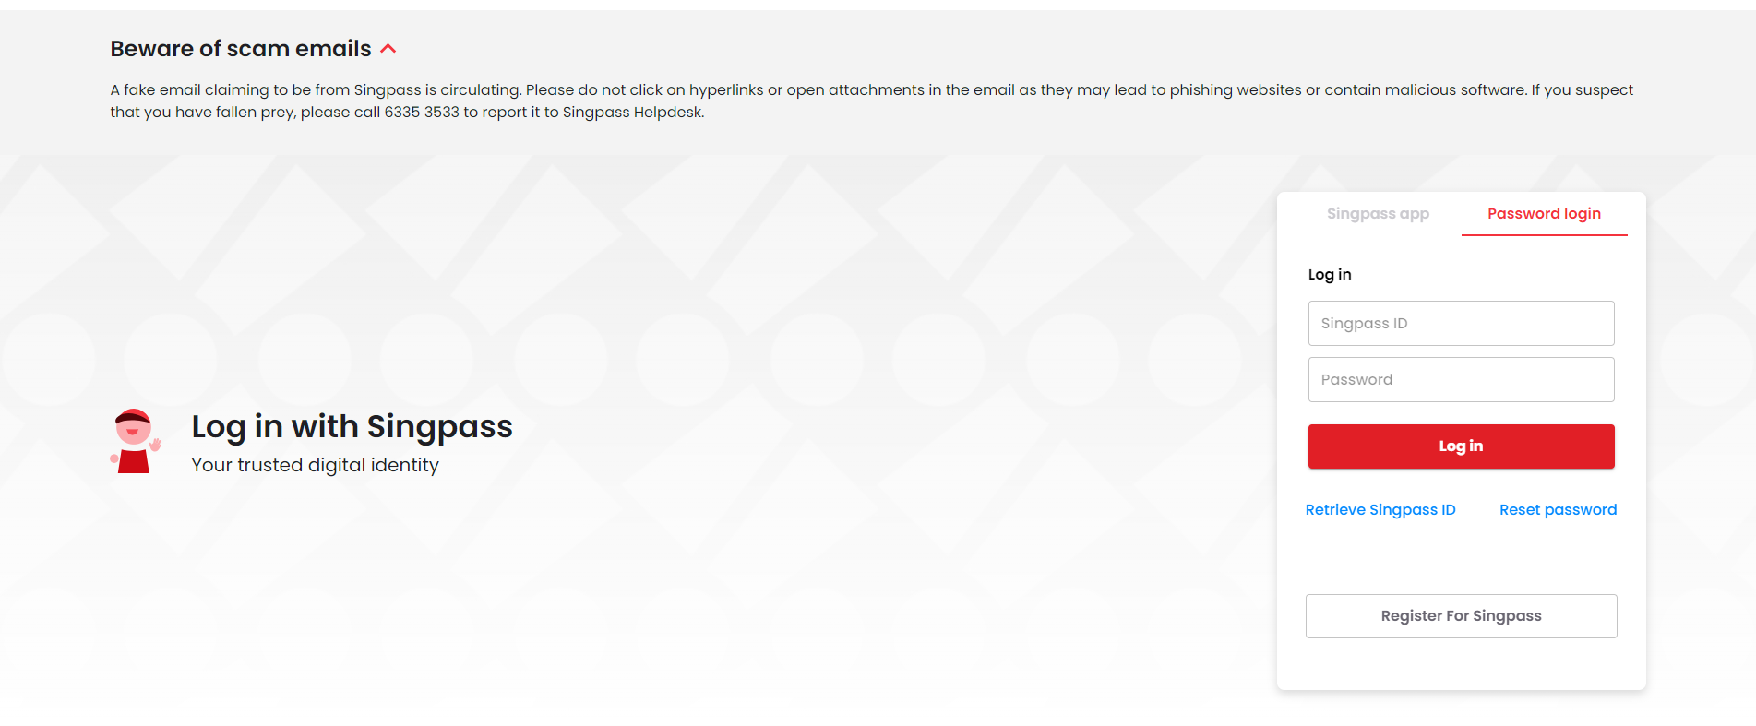
Please login using SingPass by either
Scanning the QR Code with the SingPass Mobile App OR
SingPass ID and password
Please login using the applicant’s SingPass applicant is above 21 years old.
If applicant is below 21 years old, the applicant’s parent will have to login using his/her SingPass ID

Slide 4
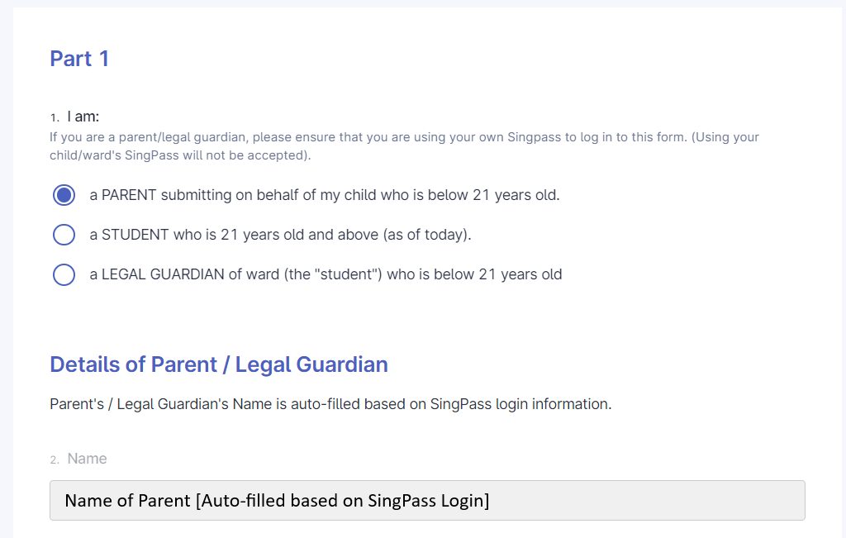
If applicant is the parent of child/account holder
4a) Click “A PARENT submitting on behalf of my child who is below 21 years old” if you are the parent of the account holder/child who is below 21 years old.

Slide 5
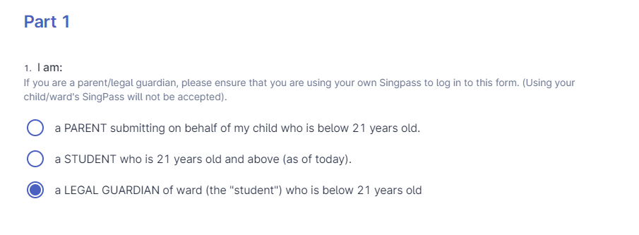
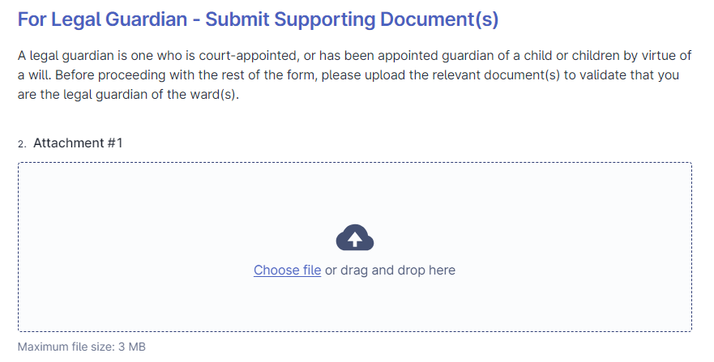
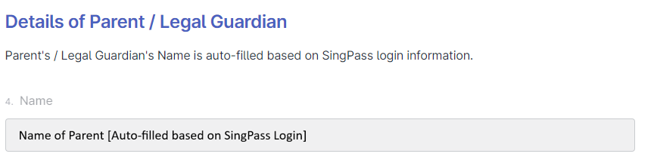
If applicant is a LEGAL GUARDIAN of child/account holder
4a) Click “a LEGAL GUARDIAN of ward (the “student”) who is below 21 years old” if you are the Legal Guardian of the account holder/child who is below 21 years old.
4b) Upload the relevant supporting documents indicating that you are the Legal Guardian of the student

Slide 6
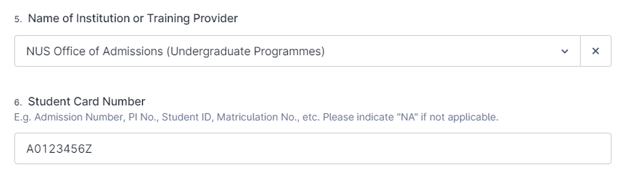
If applicant is the account holder/student
5a) Select “NUS Office of Admissions (Undergraduate Programmes”
5b) Fill in your Student Card/Matriculation Number

Slide 7
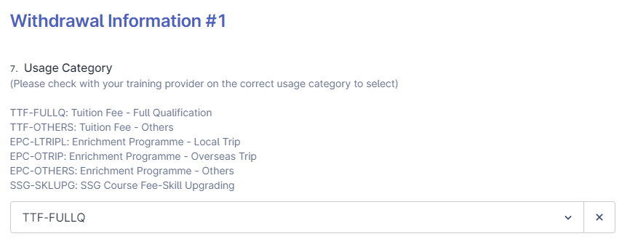
6a) Please select the usage Category as per below.
TTF-FULLQ: Tuition Fees/Miscellaneous Fees
TTF-OTHERS: Residential College Fees
EPC-LTRIPL: Enrichment Programme - Local Trip
EPC-OTRIP: Enrichment Programme - Overseas Trip
EPC-OTHERS: Compulsory Health Screening/Vaccination for Health Science students only
SSG-SKLUPG: NOT APPLICABLE for Undergraduate Programmes
Your application may not be processed if you select the wrong category.

Slide 8
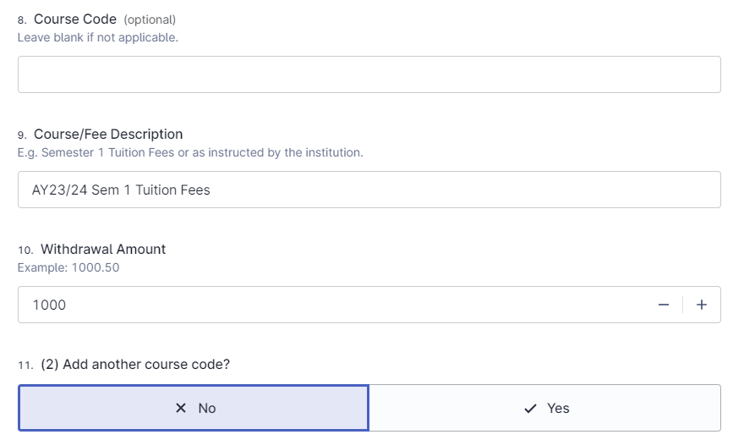
6b) Please leave “Course Code” Blank
6c) Indicate clearly the Course/Fee Description
Examples:
AY23/24 Sem 1 Tuition Fees/Misc Fees/Tuition and Misc Fees
AY23/24 Sem 1 RC Fees
AY23/24 Sem 1 SEP/NOC
AY23/24 Summer Programme
AY23/24 Sem 1 Vaccination
6c) Select “No”

Slide 9
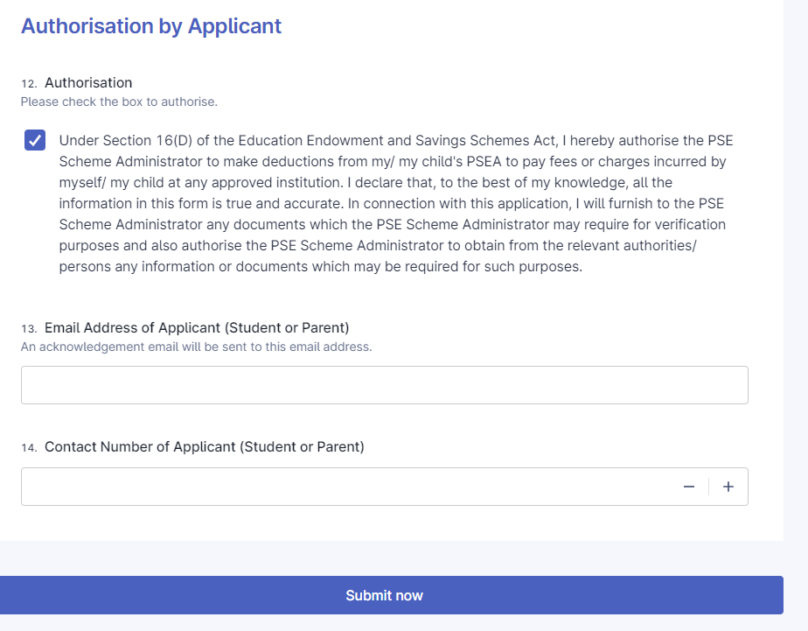
7a) Check this box
7b) Fill in the email and contact number accordingly
7c) Click “Submit Now”

Slide 10
Submitting supporting documents
7a) Check this box
7b) Fill in the email and contact number accordingly
7c) Click “Submit Now”
7d) If you are making a withdrawal for RC Fees, Overseas/Local Enrichment Programmes, or Vaccination/Health checkup, please be reminded to submit your supporting documents at https://www.askadmissions.nus.edu.sg/app/utils/login_form/redirect/ask. Incomplete applications will not be processed.

Slide 11
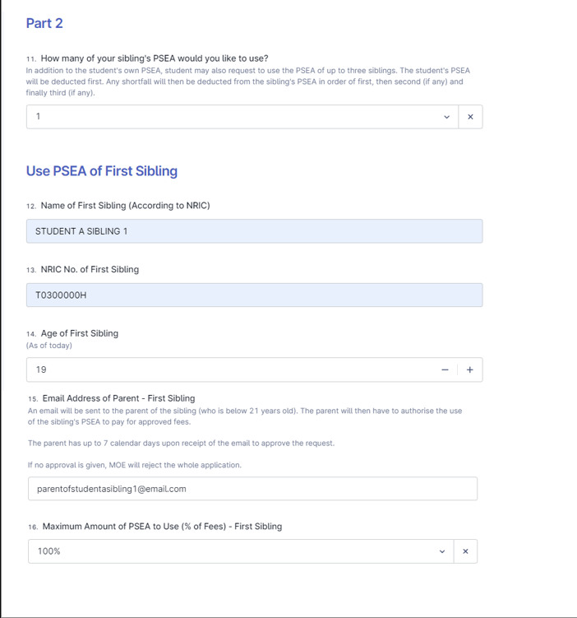
If using sibling’s PSEA
1a) Complete Part 1 of the form as per normal
1b) In Part 2, Indicate the number of siblings’ PSEA to be utilised (max 3)
1c) Fill in the particulars of the sibling(s)
1d) Fill in the email address of the
Sibling if sibling is ≥ 21 years old
Parent/Legal Guardian of sibling if < 21 years old
1e) Indicate the maximum amount of PSEA to be used for each sibling
1f) Complete and submit the rest of the form as per normal

Slide 12
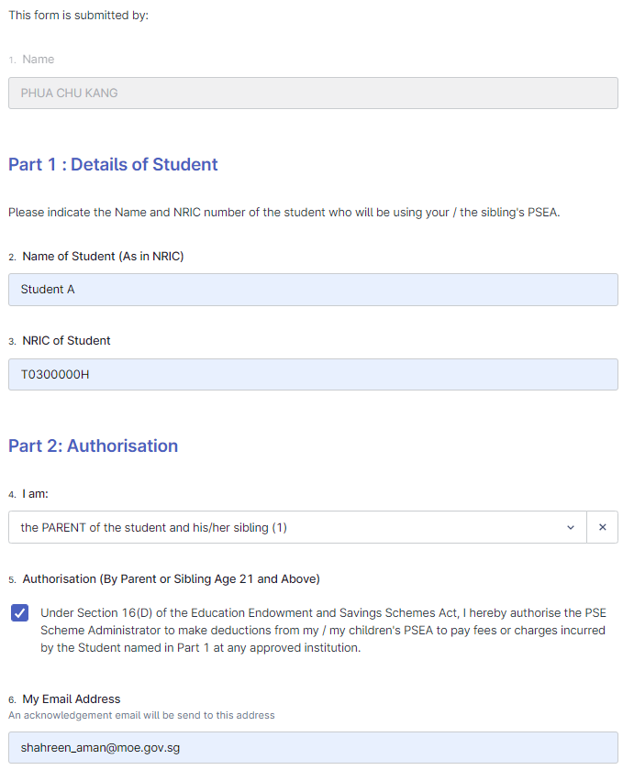
If using sibling’s PSEA
2a) Once the main form is submitted, an automated email will be sent to the sibling/parent of sibling to authorise the withdrawal
2b) After opening the form, the name of the sibling/parent of sibling will be auto-filled by SingPass
2c) Fill in the particulars of the student whose fees are to be paid
2d) Indicate who is submitting the authorisation form accordingly (sibling or parent of sibling)
2e) Check this box
2f) Fill in an email address to receive the acknowledgement email
Please note that the application will not be processed if the authorisation form is not submitted

